Slide 1
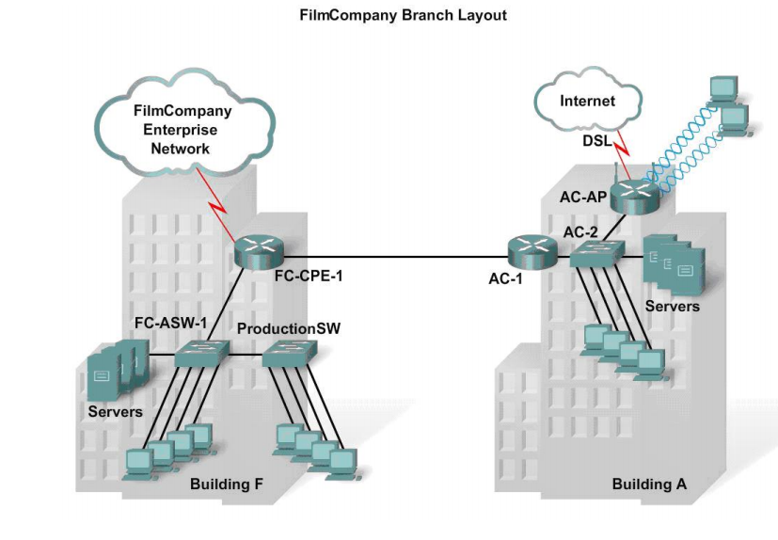

Slide 2
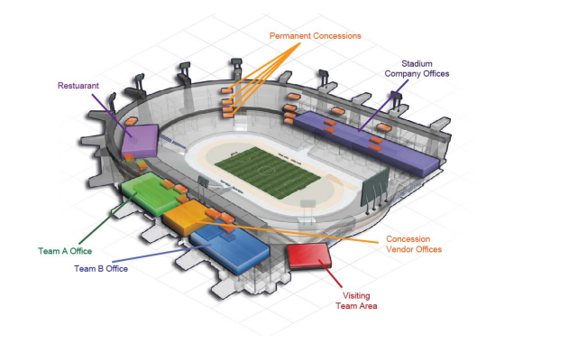

Slide 3
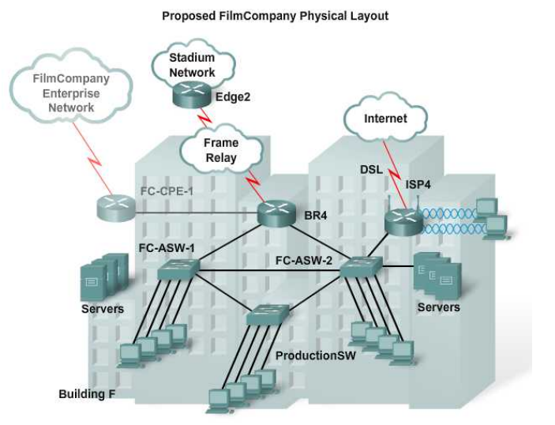

Proposed Physical Layout
R1

Slide 4
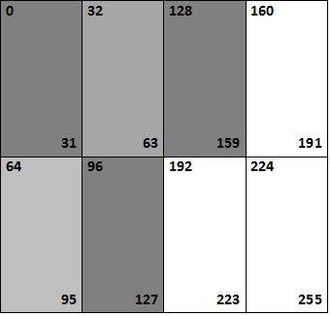
IP addressing scheme with Classful Subnetting
Class C : 192.168.0.246

Slide 5
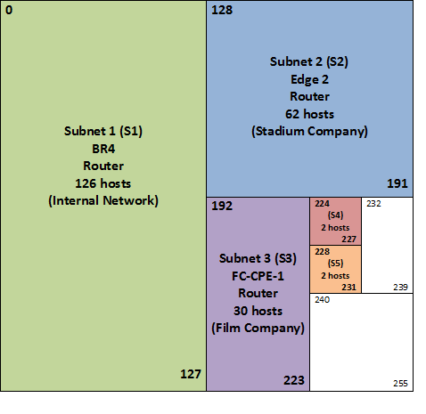
IP addressing scheme using Classless Subnetting (VLSM)
Class C : 192.168.0.246

Slide 6
Class C : 192.168.0.246
(S1) – BR4 Router (main connects to R1): 192.168.0.246/25
126 Usable Host Addresses - 192.168.0.0 to 192.168.0.127
(S2) – Edge 2 Router (Stadium Company): 192.168.0.246/26
62 Usable Host Addresses - 192.168.0.128 to 192.168.0.191
(S3) – FC-CPE-1 Router (Film Company): 192.168.0.246/27
30 Usable Host Addresses - 192.168.0.192 to 192.168.0.223
(S4) – Edge 2 Router (frame Relay Connection): 192.168.0.246/30
2 Usable Host Addresses - 192.168.0.224 to 192.168.0.227
(S5) – FC-CPE-1 Router (Connection to BR4): 192.168.0.246/30
2 Usable Host Addresses - 192.168.0.228 to 192.168.0.231

Slide 7



R1
(S2)
(S4)
(S3)
(S5)
(S1)

Slide 8
Outside User Access (restricted) IP addressing scheme
Class A: 10.10.0.0/24 – (For WiFi connection)
Using a private type IP address to restrict user access to the company’s files for more security.
253 reassignable host addresses
Class B: 180.68.0.0/24 – (For DSL Internet)
Using different IP address to restrict access to the company’s files for more security.
253 reassignable host addresses

Slide 9
R1
(S2)
(S4)
Class B: 180.68.0.0/24
(S3)
Class A: 10.10.0.0/24
(S5)
(S1)

Slide 10
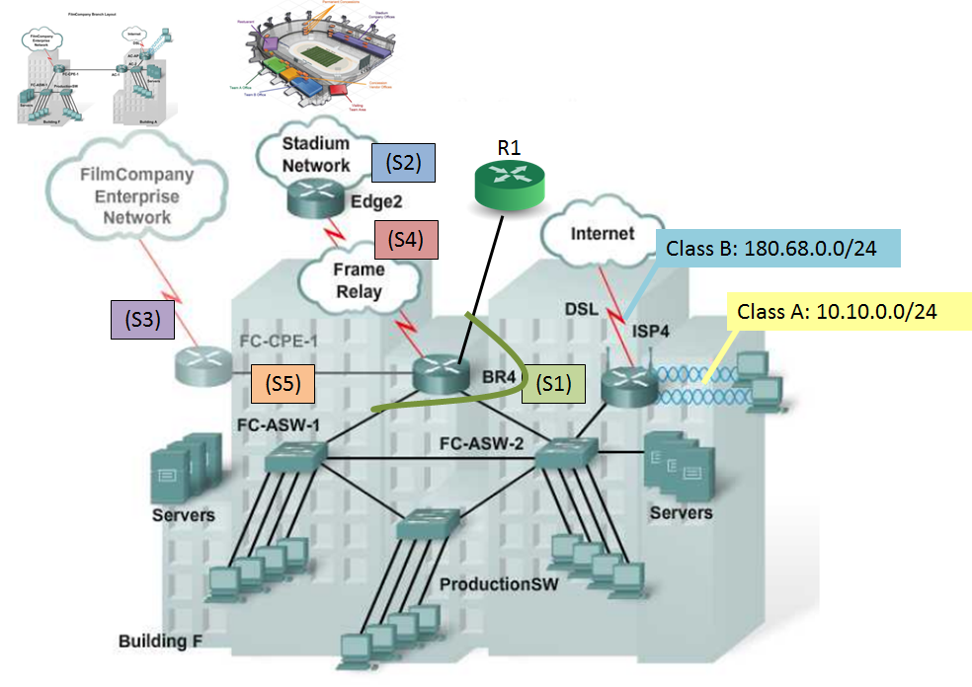
(S1)
(S2)
(S3)
(S4)
(S5)

